Slide 1

Raspberry Pi Computer Vision
Lecturer: Reza Arjmandi
Summer 2016
Preface:
Computer vision (CV) allows your Raspberry Pi to see things. In practical terms, this means that your Raspberry Pi can analyze an image, looking for items of interest and even recognizing faces and text.

Slide 2
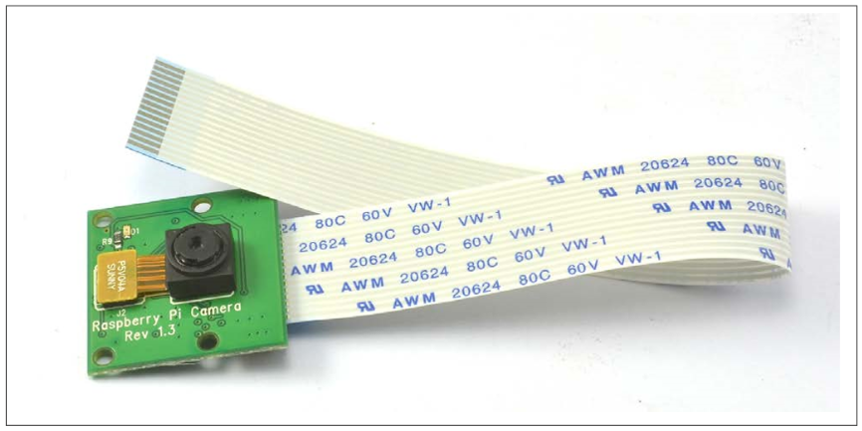
Installing the Raspberry Pi Camera Module
You want to use the Raspberry Pi camera module
The Raspberry Pi camera module (following Figure) is attached to a Raspberry Pi by a ribbon cable.

Slide 3
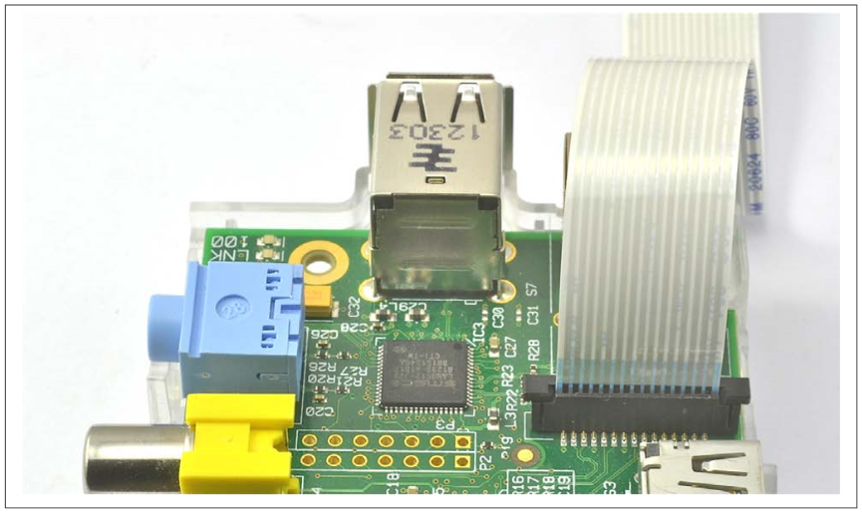
Installing the Raspberry Pi Camera Module
This cable attaches to a special connector just behind the Ethernet socket. To fit it, pull up the levers on either side of the connector, so that they unlock, and then press the cable into the slot with the connector pads of the cable facing away from the Ethernet socket. Press the two levers of the connector back down to lock the cable in place ( following Figure).

Slide 4
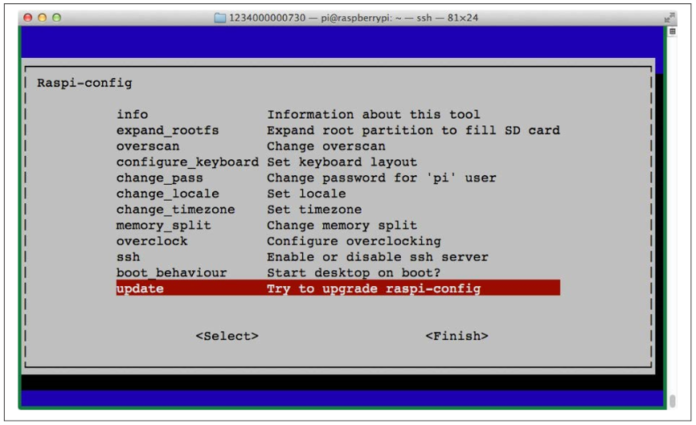
Installing the Raspberry Pi Camera Module
NOTE: The camera module packaging states that it is sensitive to static. So, before handling it, ground yourself by touching something grounded like the metal case of a PC.
The camera module requires some software configuration. The easiest way to configure it is to use raspi_config . To run raspi-config, enter the following command into a Terminal session.
$ sudo raspi-config
You will then see a list of options like those shown in following Figure

Slide 5
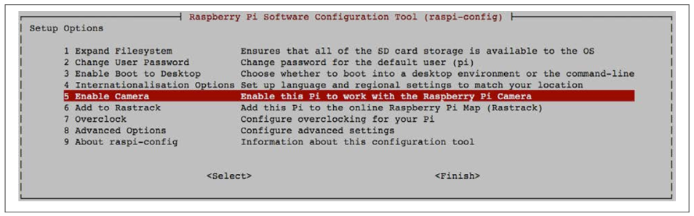
Installing the Raspberry Pi Camera Module
If the option Camera is not in the list, then you need to update the operating system by running the following commands in a Terminal session:
$ sudo apt-get update
$ sudo apt-get upgrade
You need an Internet connection to do this. The second of these commands may take a few minutes to complete. When they are complete, reboot your Raspberry Pi.
Now, when you run raspi-config you will see the option to enable the camera (following Figure).

Slide 6
Installing the Raspberry Pi Camera Module
Two commands are available for capturing still images and videos: raspiStill and raspivid.
To capture a single still image, use the raspiStill command as shown here:
$ raspistill -o image1.jpg
A preview screen displays for about five seconds and then takes a photograph and stores it in the file image1.jpg in the current directory.
To capture video, use the command raspivid:
$ raspivid -o video.h264 -t 10000
The number on the end is the recording duration in milliseconds—in this case, 10 seconds.
Both raspstill and raspivid have a large number of options. If you type either command without any parameters, help text displays options that are available.
An alternative to the camera module is to use a USB webcam

Slide 7
Installing OpenCV
To install SimpleCV, first install the prerequisite packages using these commands:
$ sudo apt-get update
$ sudo apt-get install ipython python-opencv python-scipy
$ sudo apt-get install python-numpy python-setuptools python-pip
$ sudo pip install svgwrite
Download latest release of python library and copy python dynamic library(cv2.pyd) to following directory:
$ sudo cp cv2.pyd /usr/local/lib/python2.7/site-packages

Slide 8

Installing SimpleCV
OpenCV (Open Source Computer Vision Library) is released under a BSD license and hence it’s free for both academic and commercial use. It has C++, C, Python and Java interfaces and supports Windows, Linux, Mac OS, iOS and Android. OpenCV was designed for computational efficiency and with a strong focus on real-time applications. Written in optimized C/C++, the library can take advantage of multi-core processing. Enabled with OpenCL, it can take advantage of the hardware acceleration of the underlying heterogeneous compute platform.
Computer vision is both processor- and memory-intensive, so OpenCV will work on an older Raspberry Pi, it can be frustratingly slow on anything earlier than a Raspberry Pi 3 or 2.

Slide 9
Setting Up a USB Camera for Computer Vision
Use a USB webcam that is compatible with the Raspberry Pi (see http://elinux.org/ RPi_USB_Webcams). Choose a good quality camera, and if you are working on a project where you need the camera close to the subject, select one that has a manual focus option. For getting really close to the subject, a low-cost USB endoscope can be useful.

Slide 10
Setting Up a USB Camera for Computer Vision
You can test out your USB camera from the SimpleCV console. Start SimpleCV and then enter the commands shown below in bold:
SimpleCV:1> c = Camera()
VIDIOC_QUERYMENU: Invalid argument
VIDIOC_QUERYMENU: Invalid argument
VIDIOC_QUERYMENU: Invalid argument
VIDIOC_QUERYMENU: Invalid argument
VIDIOC_QUERYMENU: Invalid argument
VIDIOC_QUERYMENU: Invalid argument
VIDIOC_QUERYMENU: Invalid argument
SimpleCV:2> i = c.getImage()
SimpleCV:3> i
SimpleCV:3: <SimpleCV.Image Object size:(640, 480), filename: (None), at memory location: (0x2381af8)>
SimpleCV:4> i.show()
Don’t worry about the Invalid argument messages.
When you issue the command i.show(), a second window opens showing the image just captured from the camera.

Slide 11
Using a Raspberry Pi Camera Module for Computer Vision
You want to use a Raspberry Pi Camera Module that connects directly to your Raspberry Pi with OpenCV.
The Raspberry Pi Camera Module does not automatically show up as a camera device. The easiest way to make the module work with SimpleCV is to use the picamera Python module to capture an image with the camera.

Slide 12
Using a Raspberry Pi Camera Module for Computer Vision
The following class will use picamera to capture an image, save it to a temporary file, and then load it as an Image suitable for use with SimpleCV
from picamera import PiCamera
from picamera.array import PiRGBArray
from PIL import Image
import numpy
import cv2
class CaptureDeviceRPiCamera:
def __init__(self, frameSize, frameRate):
camera = PiCamera()
camera.resolution = frameSize
camera.framerate = frameRate
self.rawCapture = PiRGBArray(camera, size=frameSize)
self.bufferIter = camera.capture_continuous(self.rawCapture, format="bgr", use_video_port=True)

Slide 13
Using a Raspberry Pi Camera Module for Computer Vision
def GrabFrame(self, gray):
mat = self.bufferIter.next().array
self.rawCapture.truncate(0)
if(not gray):
return mat
return cv2.cvtColor(mat, cv2.COLOR_BGR2GRAY)

Slide 14
CaptureDevice Class for grabing frame from Image, Video or Webcam source
The following class will use opencv to capture image, video or webcam source for image processing
import cv2
class CaptureDevice:
def __init__(self, mode, address):
self.inputMode = mode
self.addressFile = address
if(mode == "-v"):
self.cap = cv2.VideoCapture(address)
if(mode == "-w"):
self.cap = cv2.VideoCapture(0)

Slide 15
CaptureDevice Class for grabing frame from Image, Video or Webcam source
def GrabFrame(self, gray):
if(self.inputMode == "-i"):
if(not gray):
return cv2.imread(self.addressFile)
return cv2.imread(self.addressFile, 0)
elif(self.inputMode == "-v" or self.inputMode == "-w"):
if(self.inputMode == "-v"):
if(not self.cap.isOpened()):
return
ret, frame = self.cap.read()
if(not gray):
return frame
gray = cv2.cvtColor(frame, cv2.COLOR_BGR2GRAY)
return gray

Slide 16
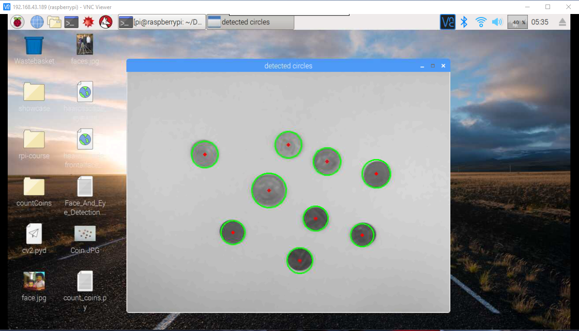
Counting_Coins Project
This should open up an image of your coins that looks something like following figure:

Slide 17
Counting_Coins Project
import cv2
import numpy as np
import sys
import CaptureDevice
try:
import cv2.cv as cv
except: pass
def CountCoins(img, cimg):
circles = None
try:
circles = cv2.HoughCircles(img, cv2.HOUGH_GRADIENT, 1, 20,
param1=50, param2=30, minRadius=0, maxRadius=0)
except:
circles = cv2.HoughCircles(img, cv.CV_HOUGH_GRADIENT, 1, 20, param1=50, param2=30, minRadius=0, maxRadius=0)

Slide 18
Counting_Coins Project
if(circles == None):
return
circles = np.uint16(np.around(circles))
for i in circles[0, :]:
# draw the outer circle
cv2.circle(cimg, (i[0], i[1]), i[2], (0, 255, 0), 2)
# draw the center of the circle
cv2.circle(cimg, (i[0], i[1]), 2, (0, 0, 255), 3)
if __name__ == "__main__":
captureDevice = CaptureDevice.CaptureDevice(sys.argv[1], sys.argv[2])
while(True):
img = captureDevice.GrabFrame(True)
img = cv2.medianBlur(img, 5)
cimg = cv2.cvtColor(img, cv2.COLOR_GRAY2BGR)
CountCoins(img, cimg)
cv2.imshow('detected circles',cimg)
if (cv2.waitKey(1) and 0xFF == ord('q')):
break
cv2.destroyAllWindows()

Slide 19
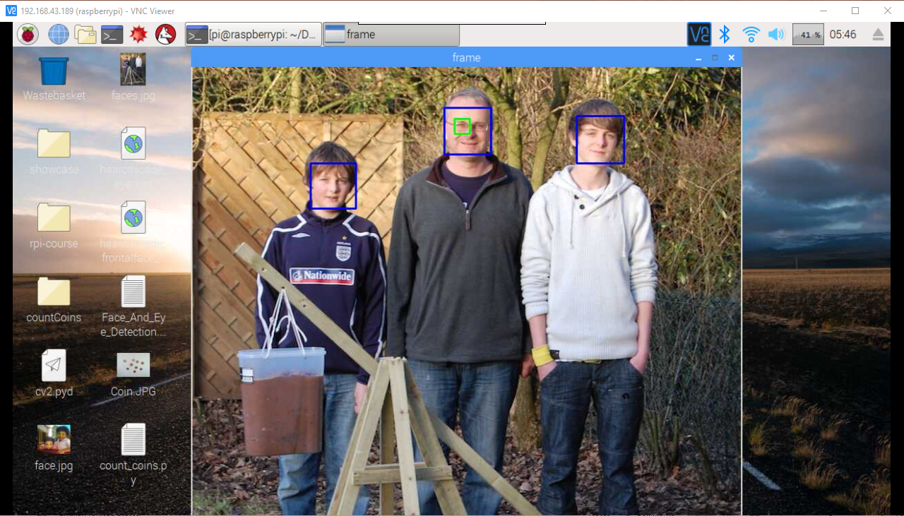
Face_And_Eye_Detection Project
This opens the image viewing window with the faces marked with rectangles, as shown in following figure:

Slide 20
Face_And_Eye_Detection Project
import cv2
import CaptureDevice
import sys
faceCascade = cv2.CascadeClassifier('haarcascade_frontalface_default.xml')
eyeCascade = cv2.CascadeClassifier('haarcascade_eye.xml')
def DetectFacesAndEyes(mat):
gray = cv2.cvtColor(mat, cv2.COLOR_BGR2GRAY)
faces = faceCascade.detectMultiScale(gray, 1.3, 5)
for (x, y, w, h) in faces:
cv2.rectangle(mat, (x, y), (x + w, y + h), (255, 0, 0), 2)
roiGray = gray[y:y + h, x:x + w]
roiColor = mat[y:y + h, x:x + w]
eyes = eyeCascade.detectMultiScale(roiGray)
for (ex, ey, ew, eh) in eyes:
cv2.rectangle(roiColor, (ex, ey), (ex + ew, ey + eh), (0, 255, 0), 2)

Slide 21
Face_And_Eye_Detection Project
if __name__ == "__main__":
device = CaptureDevice.CaptureDevice(sys.argv[1], sys.argv[2])
while(True):
frame = device.GrabFrame(False)
DetectFacesAndEyes(frame)
cv2.imshow('frame', frame)
if(cv2.waitKey(1) and 0xFF == ord('q')):
break
cv2.destroyAllWindows()

Slide 22
Face Password Project
import picamera
import time
from SimpleCV import Color, Image, np
import RPi.GPIO as GPIO
quality = 400
minMatch = 0.3
RedLED = 18
GreenLED = 23
YellowLED = 24
try:
password = Image("password.jpg")
except:
password = None
mode = "unsaved“
saved = False
minDist = 0.25

Slide 23
Face Password Project
GPIO.setmode(GPIO.BCM)
GPIO.setup(RedLED, GPIO.OUT)
GPIO.setup(GreenLED, GPIO.OUT)
GPIO.setup(YellowLED, GPIO.OUT)
with picamera.PiCamera() as camera:
while True:
camera.start_preview()
time.sleep(10)
camera.capture('pifacepw.jpg')
image=Image("pifacepw.jpg")
camera.stop_preview()
faces = image.findHaarFeatures("face.xml")
if faces:
if not password:
faces.draw()
face = faces[-1]
password = face.crop().save("password.jpg")
print "First Run Application"
print "Exit Program"
break

Slide 24
Face Password Project
else:
faces.draw()
face = faces[-1]
template = face.crop()
template.save("passwordmatch.jpg")
template = Image("passwordmatch.jpg")
diff = template.resize(password.width, password.height) - password;
#keypoints = password.findKeypointMatch(template, quality, minDist, minMatch)
if diff.findBlobs(minsize = 1000):
print "Face not matched"
print "Danger"
GPIO.output(GreenLED, 0)
GPIO.output(RedLED, 1)
GPIO.output(YellowLED, 0)
else:
print "your face detected and matched"
print "Welcome to Application"
GPIO.output(GreenLED, 1)
GPIO.output(RedLED, 0)
GPIO.output(YellowLED, 0)

Slide 25
Face Password Project
else:
print "No face found"
print "Please look at the camera"
GPIO.output(GreenLED, 0)
GPIO.output(RedLED, 0)
GPIO.output(YellowLED, 1)

Slide 26
Motion Detection
Use SimpleCV to detect changes between successive frames from the camera. The program below compares each captured image with the previous image. It then detects any blobs (areas of similar color) in the difference image and if there are any larger than MIN_BLOB_SIZE, it prints out a message saying that movement was detected.
from SimpleCV import *
MIN_BLOB_SIZE = 1000
c = Camera()
old_image = c.getImage()
while True:
new_image = c.getImage()
diff = new_image - old_image
blobs = diff.findBlobs(minsize=MIN_BLOB_SIZE)
if blobs :
print("Movement detected")
old_image = new_imag
Successive frames of the image might look like following figure. When the first image is subtracted from the first, the resulting image will look like next Figure. Running blob detection on it will result in the outlined blobs shown in Next Figure.

Slide 27
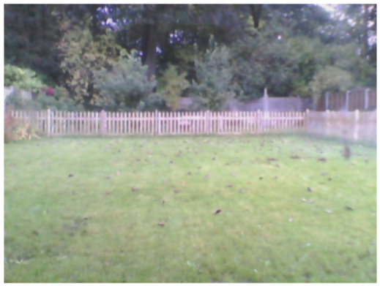
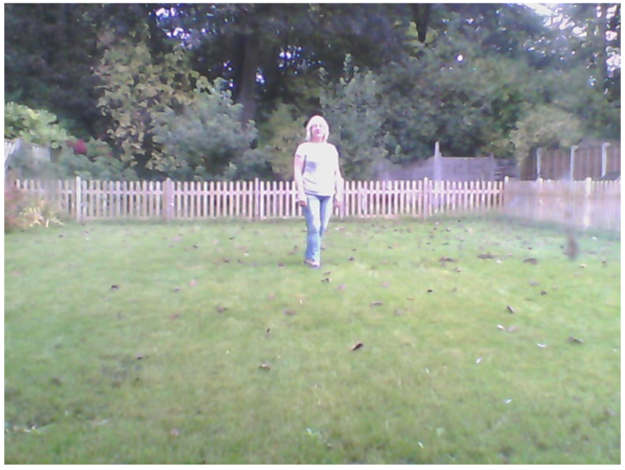
Motion Detection

Slide 28
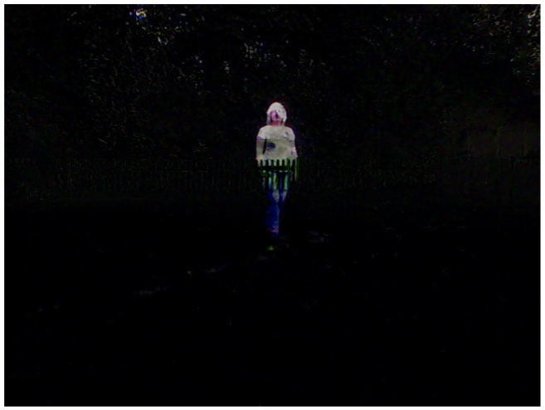
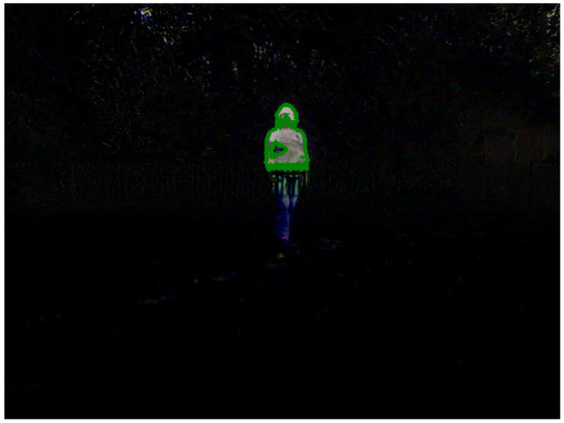
Motion Detection

Slide 29
Optical Character Recognition
Use the tesseract Optical Character Recognition (OCR) software to extract text from the image.
To install tesseract, run the following commands:
$ sudo apt-get install python-distutils-extra tesseract-ocr tesseract-ocr-eng
libopencv-dev libtesseract-dev libleptonica-dev python-all-dev swig libcv-dev python-opencv python-numpy python-setuptools build-essential subversion
$ sudo apt-get install tesseract-ocr-eng tesseract-ocr-dev libleptonica-dev
python-all-dev swig libcv-dev
$ sudo svn checkout
http://python-tesseract.googlecode.com/svn/python-tesseract-0.7.4/
$ cd python-tesseract-0.7.4
$ sudo python setup.py build
$ sudo python setup.py install

Slide 30
Optical Character Recognition
To try out tesseract, you will need an image file that contains some text.
$ tesseract ocr_example.png found
Tesseract Open Source OCR Engine v3.02 with Leptonica
$ more found.txt
The quick brown fox jumped over
the lazy dogs back.
$
The tesseract library will work with most image types, including PDF, PNG, and JPG files.
For more information on the tesseract library, see https://github.com/tesseract-ocr/ tesseract/wiki/TrainingTesseract.

Slide 31


Contact us
www.e-system.ir
Info@e-system.ir

